Slide 1
U.S. Department of Defense Contract Spending and Industrial Base: Highlights relevant to U.S.-ROK Strategic Cooperation of Defense Acquisition January 22, 2015
Gregory Sanders, Fellow
Drawing from research conducted with: David Berteau, Jesse Ellman, Rhys McCormick, Joshua Archer, Sam Brothers, Roy Levy, Daniel Massey, and Adam Schwartzman.
Project Director: Andrew Hunter
Defense-Industrial Initiatives Group
Center for Strategic & International Studies
Notes:
14:05 0 minutes 1:30
Thank you for having me, I’m delighted to have this opportunity. Specific thanks to our moderator Dr. Cha of the Korea Chair and KIET President Kim Do-hoon for sponsoring this conference, as well as Dir. Jang, Won-Joon and Dr. Ann, Young Su for their past work for my program and for their partnership on a forthcoming report.
My talk today has two purposes: 1) To detail the state of the U.S. defense acquisition system.
2) To discuss the implications for U.S.-RoK partnership.

Slide 2
About CSIS
At a time of new global opportunities and challenges, the Center for Strategic and International Studies (CSIS) provides strategic insights and policy solutions to decisionmakers in government, international institutions, the private sector, and civil society. A bipartisan, nonprofit organization headquartered in Washington, DC, CSIS conducts research and analysis and develops policy initiatives that look into the future and anticipate change.
Founded by David M. Abshire and Admiral Arleigh Burke at the height of the Cold War, CSIS was dedicated to finding ways for America to sustain its prominence and prosperity as a force for good in the world.
Since 1962, CSIS has grown to become one of the world’s preeminent international policy institutions, with more than 220 full-time staff and a large network of affiliated scholars focused on defense and security, regional stability, and transnational challenges ranging from energy and climate to global development and economic integration.
Former U.S. senator Sam Nunn became chairman of the CSIS Board of Trustees in 1999, and John J. Hamre has led CSIS as its president and chief executive officer since April 2000
CSIS does not take specific policy positions; accordingly, all views expressed in this presentation should be understood to be solely those of the author(s).

Slide 3
The Budget Control Act (BCA) Caps and the President’s Fiscal Year 2015 Budget (PB15)
FY15 OCO request: $58.6B
Overseas Contingency Operations (OCO) placeholder in PB15
President’s $26B “Opportunity, Growth and Security Initiative”

Slide 4
The Sequester Drawdown in Context
Post-Korea
-43%
Post-Vietnam
-33%
Post-Cold War
-36%
Current
-32%
Active Duty
Military
PB15
BCA Capped Budget
1948-2014 Budget Authority
Source: Department of Defense, National Defense Budget Estimates for FY 2015 (Green Book), Office of the Under Secretary of Defense (Comptroller), March 2014; Pat Towell and Amy Belasco, Defense: FY14 Authorization and Appropriations, Congressional Research Service, January 8, 2014. Available at http://www.fas.org/sgp/crs/natsec/R43323.pdf.

Slide 5
U.S. Defense Contracting Spending
The Federal Procurement Data System (FPDS) was the primary source for the following slides report.
Federal regulations only require that all unclassified prime contracts worth $3,000 and above be reported to FPDS.
FPDS data are constantly being updated, including those for back years. As a consequence, the dollar totals for a given year can vary between reports.
Contract classifications sometimes differ between FPDS and individual companies, resulting in some contracts that a company considers as services being labeled as products by FPDS and vice versa.
OCO and supplementals are not separately classified in FPDS.
All dollar figures are in constant 2013 dollars
Additional charts (with breakdowns by DoD component and by Products/Services/R&D), along with full data tables, are available online at http://www.csis.org/NSPIR/DoD
The following slides draw heavily on the 2013 Defense Contracting Trends report and the work of my co-author Jesse Ellman.
Notes:
14:10 5:15 minutes 1:30 seconds
The next section of the talk focuses specifically on U.S. obligations to defense contractors tracked via the Federal Procurement Data System. These slides use fiscal year and 2013 constant dollars. The data on this topic is detailed but has several important restrictions:
These are prime contract obligations, subcontract obligation reporting is still largely unreliable.
Classified spending can go unreported.
OCO and base budget spending are both included but not differentiated.
Labeling will vary between the government and vendors and even between different parts of the government.
See the latest CSIS Defense Contract Trends report that I have published with co-author Jesse Ellman and our website for more details.

Slide 6
U.S. Department of Defense (DoD) Decline in Contract Obligations in Context, 2000-2013
Source: FPDS, Office of Management and Budget, NSPIR Analysis
Notes:
14:12 6:45 minutes 1:15 seconds
In this slide, we compared the effect of sequestration cuts in 2013 on overall defense outlays and on defense contracting in particular. We went to a great deal of work to compare apples-to-apples, that I will not discuss here, see the methodology of our latest report for the details.
Defense funded contract obligations fell by 16% from 2012 to 2013. This is twice as fast as cuts in total defense gross outlays. As a result defense funded contract obligations went from a 53 percent share to a 49 percent share of outlays.
As I discussed earlier with budgets, the affects of cuts on acquisition can be greater than top level spending suggests.

Slide 7
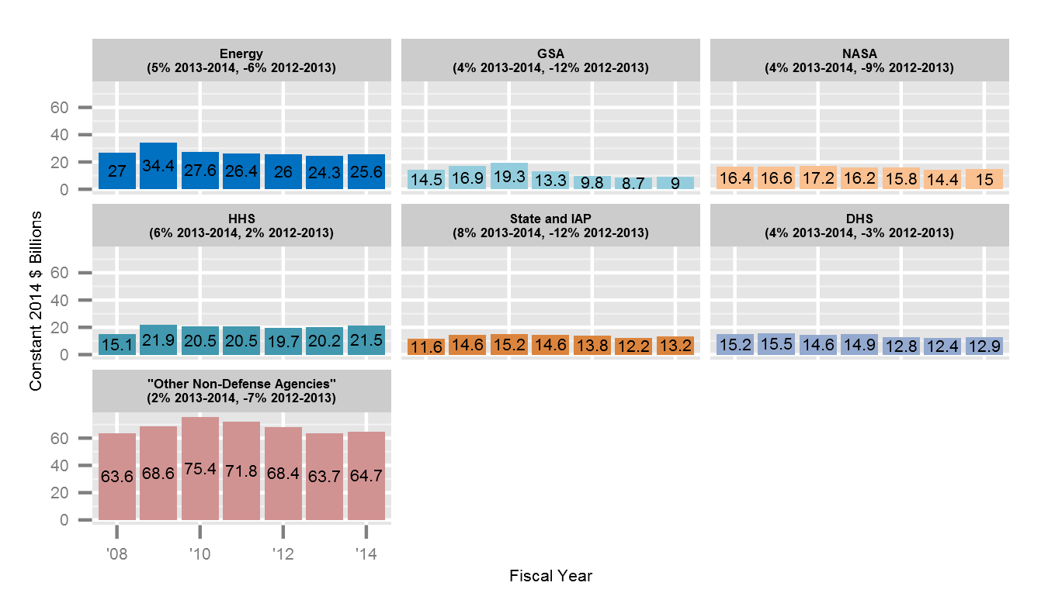
Non-Defense Contract Obligations by Customer, 2008-2014

Slide 8
DoD Contract Obligations by Component, 2000-2013
Source: FPDS, NSPIR Analysis
Notes:
14:13 8:00 minutes 1:00 seconds
Cuts during drawdown have fallen most heavily on Army contract spending has been cut most heavily since 2009.
Air Force cuts were smaller, but during sequestration it took a 22% reduction, greater than the 16% for DoD overall. Note that for the past several years, the Air Force has less contract obligations than do the Defense Logistics Agency and other DoD-wide agencies combined.
Navy did take earlier cuts, but faced smaller reductions this past year.
However, all of these adjustments are volatile.

Slide 9
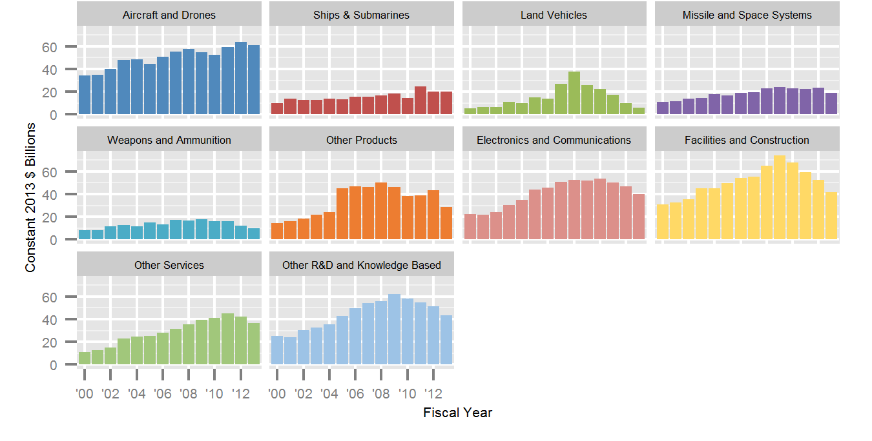
DoD Contract Obligations by Platform Portfolio, 2000-2013
Aircraft and Drones
Ships and Submarines
Land Vehicles
Missiles and Space
Weapons and Ammunition
Other Products
Electronics & Communications
Facilities & Construction
Constant 2013 $ Billions
Other Services
Other R&D & Knowledge Based
Developed by Rhys McCormick, in this chart each platform includes relevant contracts for products, services, and R&D.
Source: FPDS, NSPIR Analysis
Fiscal Year
Notes:
14:15 10:00 minutes 1:15 seconds
This chart categorizes contract obligations by platform portfolio, a methodology I developed with Rhys McCormick. Each small platform chart has the same scale and the same range of years. Unlike the last chart, the totals for platforms group together products, services, and R&D.
In the upper left, you can see that Aircraft and Drones are up, driven by the Joint Strike Fighter. One category to the right of that, Ships and Submarine spending is also stable, while most other categories are down.

Slide 10
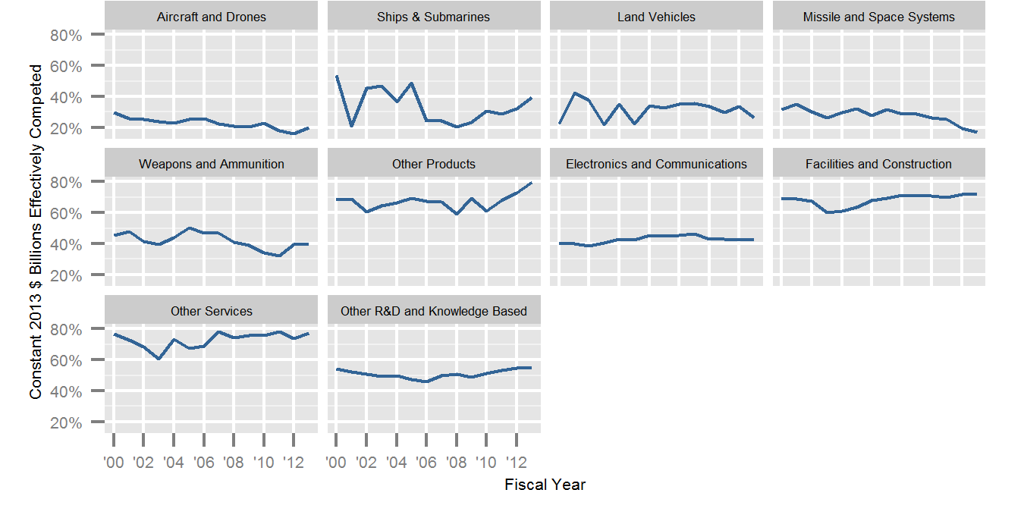
DoD Effective Competition Rates by Platform Portfolio, 2000-2013
Aircraft and Drones
Ships and Submarines
Land Vehicles
Missiles and Space
Weapons and Ammunition
Other Products
Electronics & Communications
Facilities & Construction
Percent of Contract Obligations Receiving 2 or More Offers
Other Services
Other R&D & Knowledge Based
Fiscal Year
Source: FPDS, NSPIR Analysis
Notes:
14:21 16:00 minutes 1:30 seconds
This chart returns to the platform portfolio breakdowns. Again the range of years and the percentage scale are the same for each small graphs. This time the y-axis is percentage of dollars being competed with two or more offers, “effective competition.”
Major platforms have low effective competition rates, but the details vary. Note that the aircraft and drones, as well as missile and space, the competition rat is getting worse. the rate for ships and submarine is slowly rising and may be returning to prior forty percent plus highs. Electronics and communications has also hovered around forty percent effectively competed, which is somewhat surprising given the greater applicability of commercial technology.

